Slide 1
Announcements
HW2 is due Friday, February 10, 11:59 PM PT
Project 2 is due Tuesday, February 14, 11:59 PM PT

Slide 2
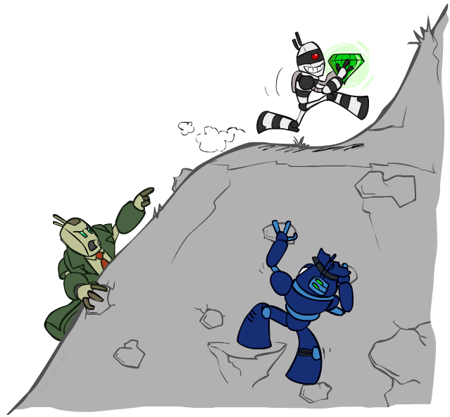
CS 188: Artificial Intelligence
Constraint Satisfaction Problems II
Spring 2023
University of California, Berkeley
[These slides were created by Dan Klein and Pieter Abbeel for CS188 Intro to AI at UC Berkeley. All CS188 materials are available at http://ai.berkeley.edu.]
Notes:
Please retain proper attribution, including the reference to ai.berkeley.edu. Thanks!

Slide 3

Today
Efficient Solution of CSPs
Iterative Improvement

Slide 4


Review: CSPs
CSPs:
Variables
Domains
Constraints
Implicit (provide code to compute)
Explicit (provide a list of the legal tuples)
Unary / Binary / N-ary
Goals:
Here: find any solution
Also: find all, find best, etc.

Slide 5
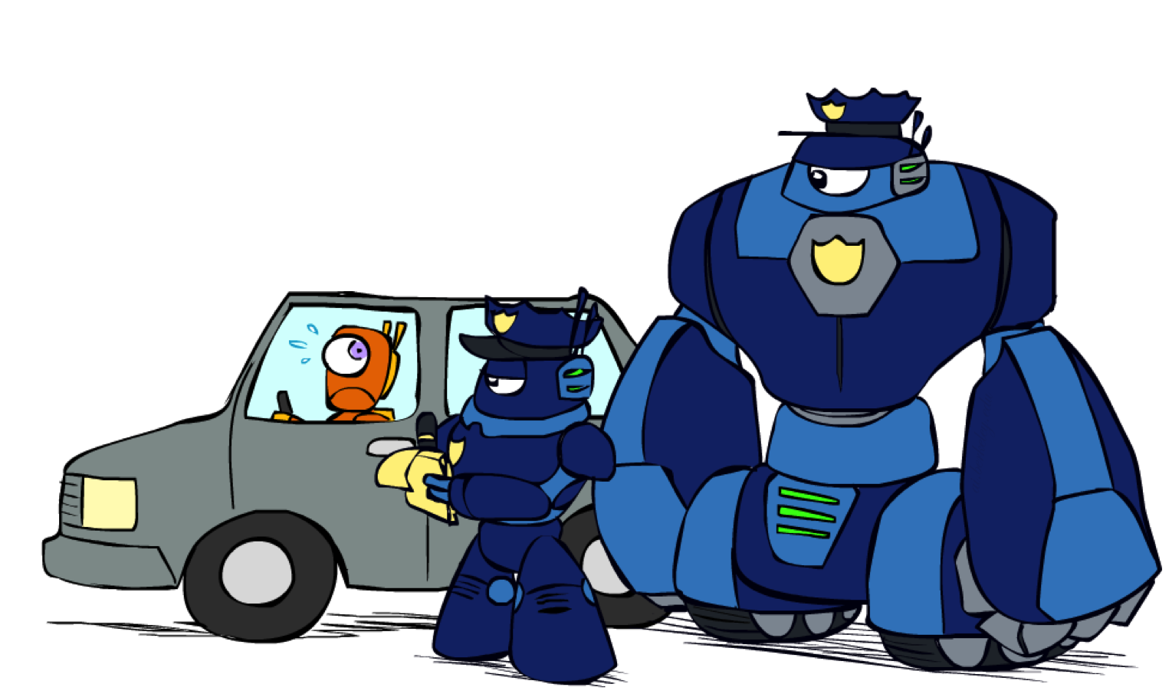
K-Consistency

Slide 6
K-Consistency
Increasing degrees of consistency
1-Consistency (Node Consistency): Each single node’s domain has a value which meets that node’s unary constraints
2-Consistency (Arc Consistency): For each pair of nodes, any consistent assignment to one can be extended to the other
K-Consistency: For each k nodes, any consistent assignment to k-1 can be extended to the k^{th} node.
Higher k more expensive to compute
(You need to know the k=2 case: arc consistency)

Slide 7
Strong K-Consistency
Strong k-consistency: also k-1, k-2, … 1 consistent
Claim: strong n-consistency means we can solve without backtracking!
Why?
Choose any assignment to any variable
Choose a new variable
By 2-consistency, there is a choice consistent with the first
Choose a new variable
By 3-consistency, there is a choice consistent with the first 2
…
Lots of middle ground between arc consistency and n-consistency! (e.g. k=3, called path consistency)

Slide 8
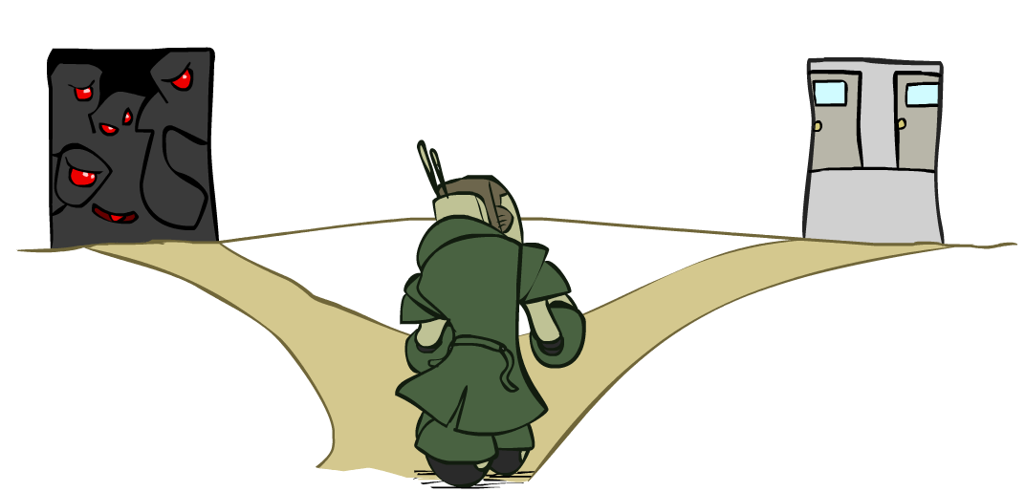
Ordering

Slide 9
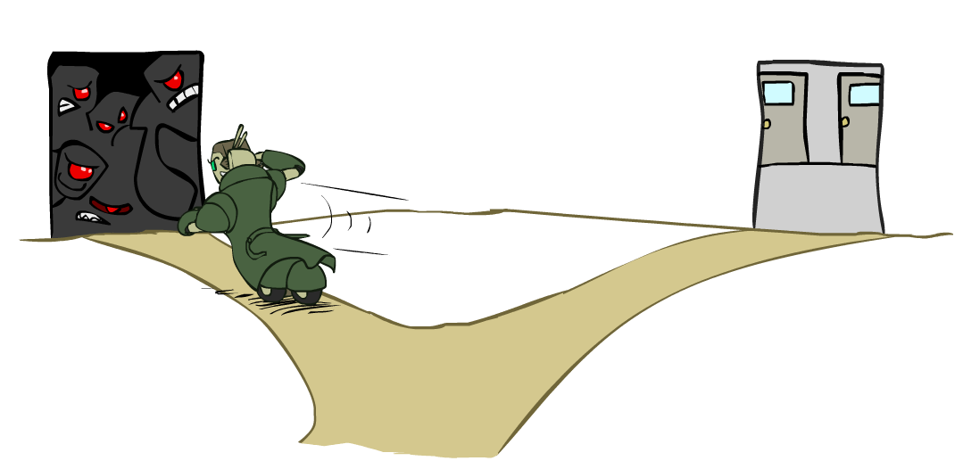
Ordering: Minimum Remaining Values
Variable Ordering: Minimum remaining values (MRV):
Choose the variable with the fewest legal left values in its domain
Why min rather than max?
Also called “most constrained variable”
“Fail-fast” ordering

Slide 10
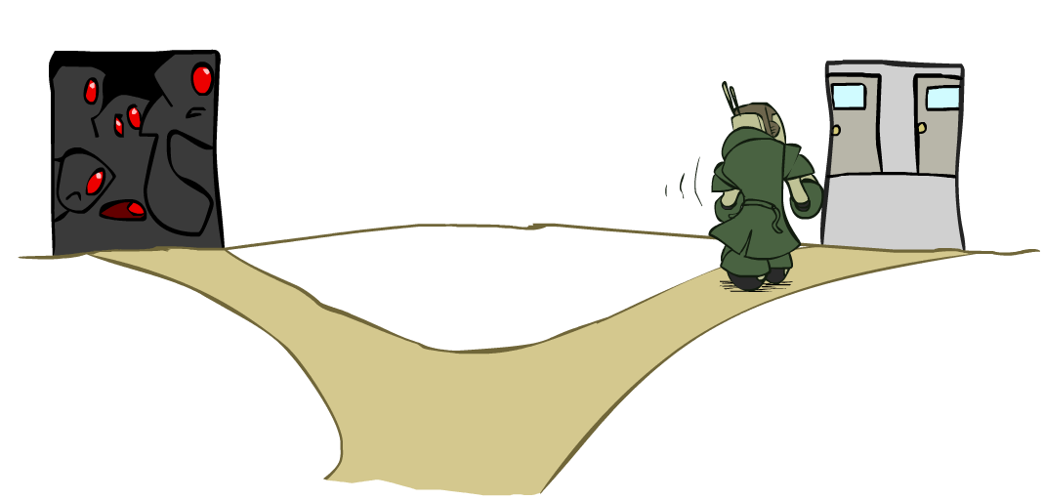
Ordering: Least Constraining Value
Value Ordering: Least Constraining Value
Given a choice of variable, choose the least constraining value
I.e., the one that rules out the fewest values in the remaining variables
Note that it may take some computation to determine this! (E.g., rerunning filtering)
Why least rather than most?
Combining these ordering ideas makes
1000 queens feasible
[Demo: coloring – backtracking + AC + ordering]
Notes:
Demo:
CS188 javascript demos -> source -> exercises -> csps -> CSPs demos -> CSPs demos.html
Settings:
Graph = Complex
Algorithm = Backtracking
Ordering = MRV
Filtering = Forward Checking
Solves already without any need for backtracking
Note: need a bigger problem to illustrate relevance of backtracking+AC+MRV+MCV

Slide 11
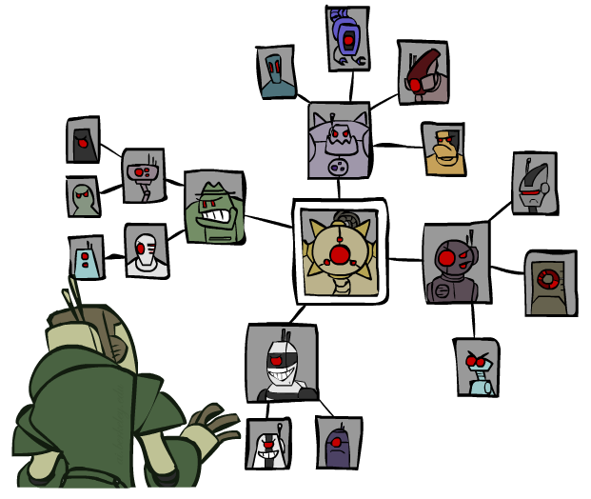
Structure

Slide 12
Problem Structure
Extreme case: independent subproblems
Example: Tasmania and mainland do not interact
Independent subproblems are identifiable as connected components of constraint graph
Suppose a graph of n variables can be broken into subproblems of only c variables:
Worst-case solution cost is O((n/c)(d^{c})), linear in n
E.g., n = 80, d = 2, c =20
2⁸⁰ = 4 billion years at 10 million nodes/sec
(4)(2²⁰) = 0.4 seconds at 10 million nodes/sec

Slide 13
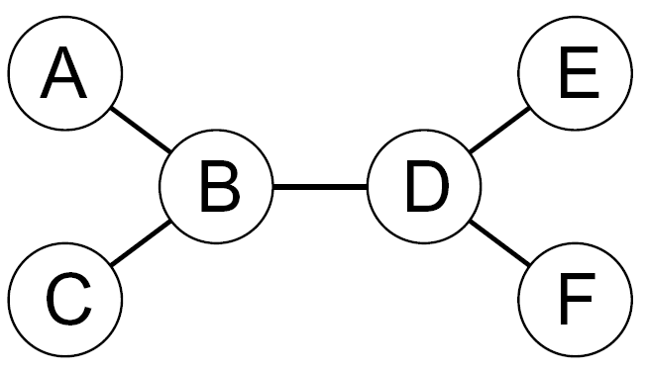
Tree-Structured CSPs
Theorem: if the constraint graph has no loops, the CSP can be solved in O(n d²) time
Compare to general CSPs, where worst-case time is O(d^{n})
This property also applies to probabilistic reasoning (later): an example of the relation between syntactic restrictions and the complexity of reasoning

Slide 14
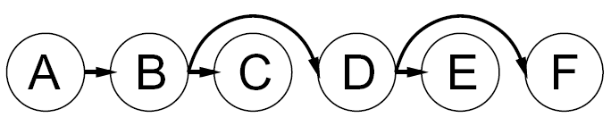
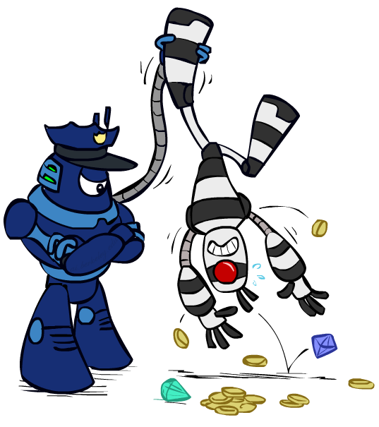

Tree-Structured CSPs
Algorithm for tree-structured CSPs:
Order: Choose a root variable, order variables so that parents precede children
Remove backward: For i = n : 2, apply RemoveInconsistent(Parent(X_{i}),X_{i})
Assign forward: For i = 1 : n, assign X_{i} consistently with Parent(X_{i})
Runtime: O(n d²) (why?)

Slide 15
Tree-Structured CSPs
Claim 1: After backward pass, all root-to-leaf arcs are consistent
Proof: Each X→Y was made consistent at one point and Y’s domain could not have been reduced thereafter (because Y’s children were processed before Y)
Claim 2: If root-to-leaf arcs are consistent, forward assignment will not backtrack
Proof: Induction on position
Why doesn’t this algorithm work with cycles in the constraint graph?
Note: we’ll see this basic idea again with Bayes’ nets

Slide 16
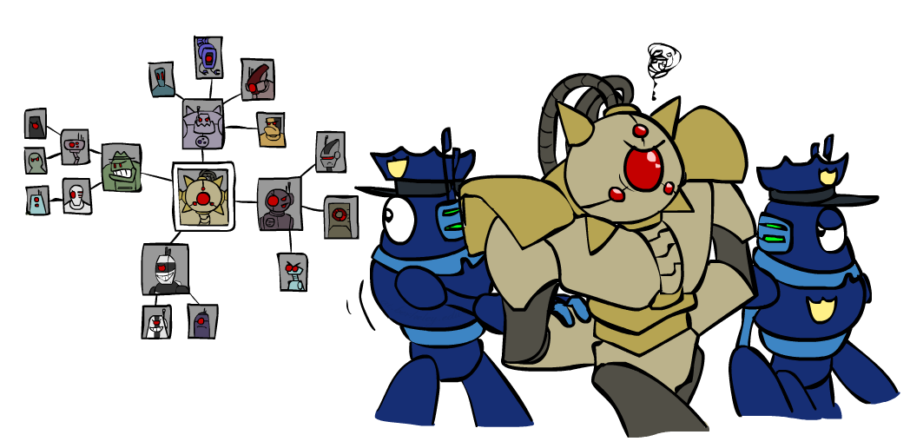
Improving Structure

Slide 17
Nearly Tree-Structured CSPs
Conditioning: instantiate a variable, prune its neighbors' domains
Cutset conditioning: instantiate (in all ways) a set of variables such that the remaining constraint graph is a tree
Cutset size c gives runtime O( (d^{c}) (n-c) d² ), very fast for small c

Slide 18
Cutset Conditioning
Choose a cutset
SA
Instantiate the cutset (all possible ways)
SA
SA
SA
Compute residual CSP for each assignment
Solve the residual CSPs (tree structured)

Slide 19
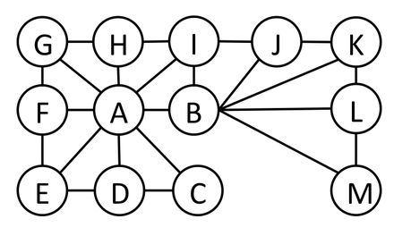
Cutset Quiz
Find the smallest cutset for the graph below.

Slide 20
Tree Decomposition*
Idea: create a tree-structured graph of mega-variables
Each mega-variable encodes part of the original CSP
Subproblems overlap to ensure consistent solutions
M1
M2
M3
M4
WA
≠
NT
NT
≠
Q
Q
≠
NSW
NSW
≠
V
≠
≠
≠
≠
≠
≠
≠
≠
SA
SA
SA
SA
Agree on shared vars
Agree on shared vars
Agree on shared vars
{(WA=r,SA=g,NT=b),
(WA=b,SA=r,NT=g),
…}
{(NT=r,SA=g,Q=b),
(NT=b,SA=g,Q=r),
…}
Agree: (M1,M2) ∈
{((WA=g,SA=g,NT=g), (NT=g,SA=g,Q=g)), …}

Slide 21
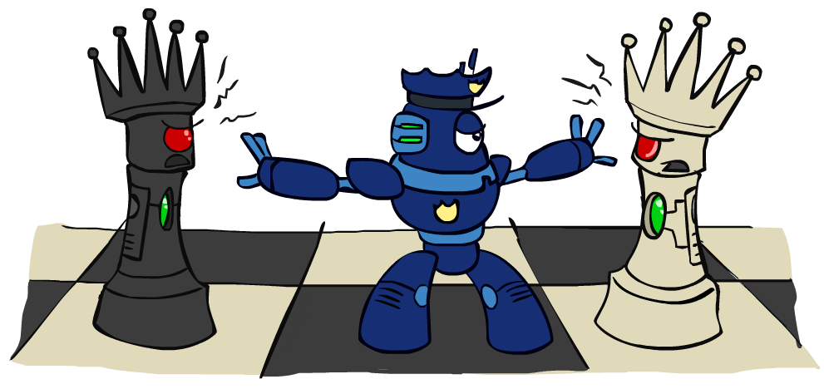
Iterative Improvement

Slide 22
Iterative Algorithms for CSPs
Local search methods typically work with “complete” states, i.e., all variables assigned
To apply to CSPs:
Take an assignment with unsatisfied constraints
Operators reassign variable values
No fringe! Live on the edge.
Algorithm: While not solved,
Variable selection: randomly select any conflicted variable
Value selection: min-conflicts heuristic:
Choose a value that violates the fewest constraints
I.e., hill climb with h(n) = total number of violated constraints

Slide 23
Example: 4-Queens
States: 4 queens in 4 columns (4⁴ = 256 states)
Operators: move queen in column
Goal test: no attacks
Evaluation: c(n) = number of attacks
[Demo: n-queens – iterative improvement (L5D1)]
[Demo: coloring – iterative improvement]
Notes:
L5D1 – python demos
Coloring – javascript demos

Slide 24
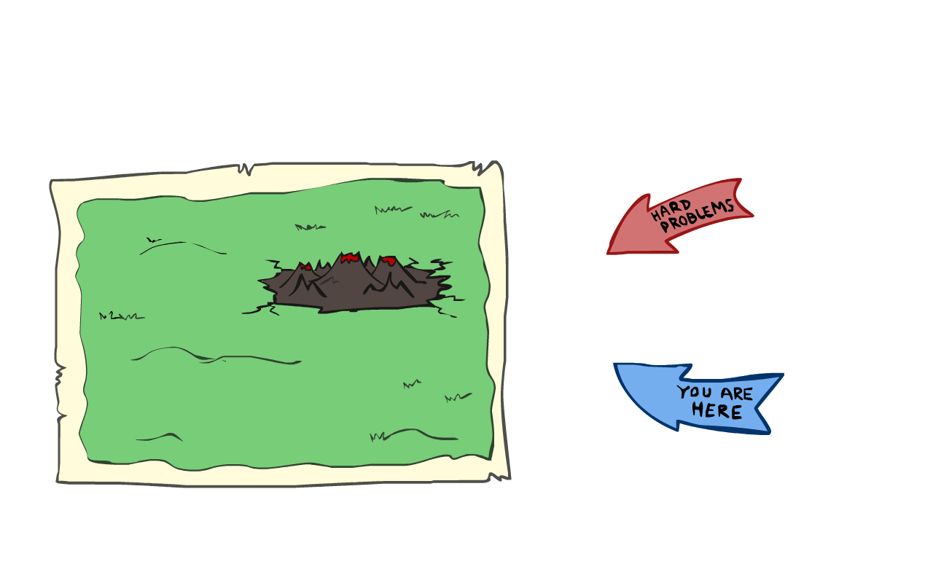
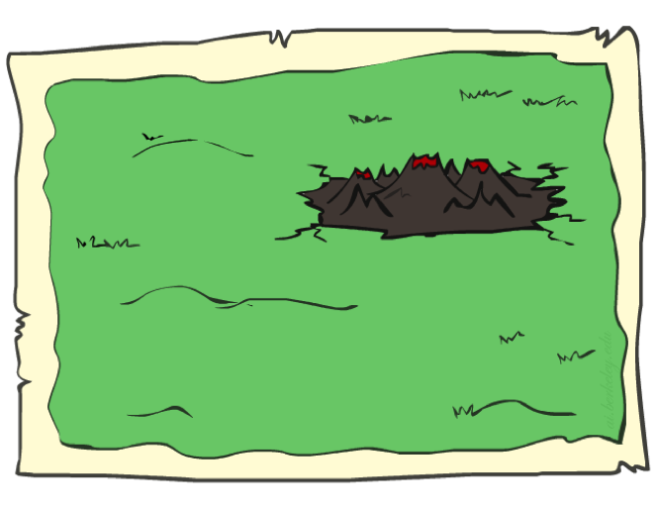
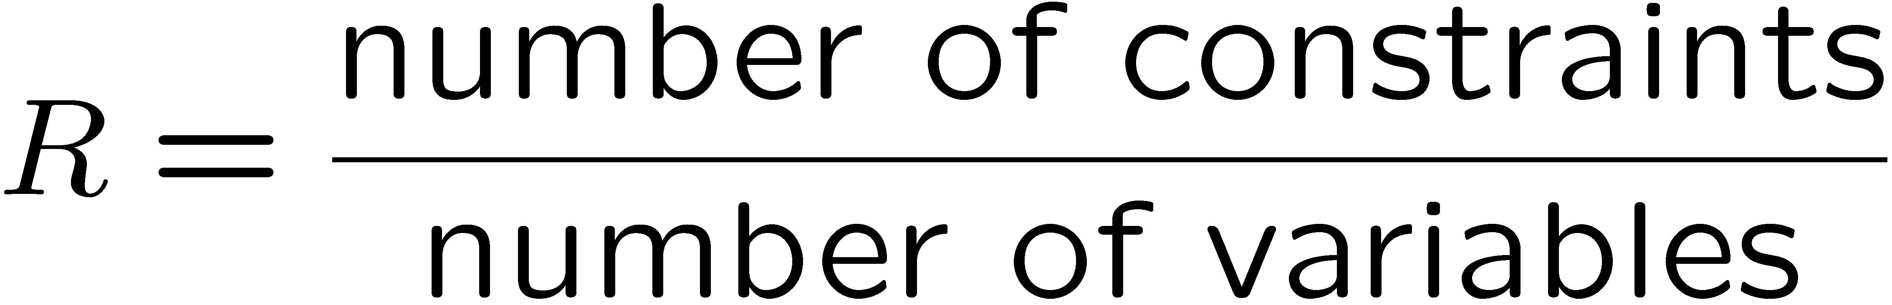
Performance of Min-Conflicts
Given random initial state, can solve n-queens in almost constant time for arbitrary n with high probability (e.g., n = 10,000,000)!
The same appears to be true for any randomly-generated CSP except in a narrow range of the ratio

Slide 25
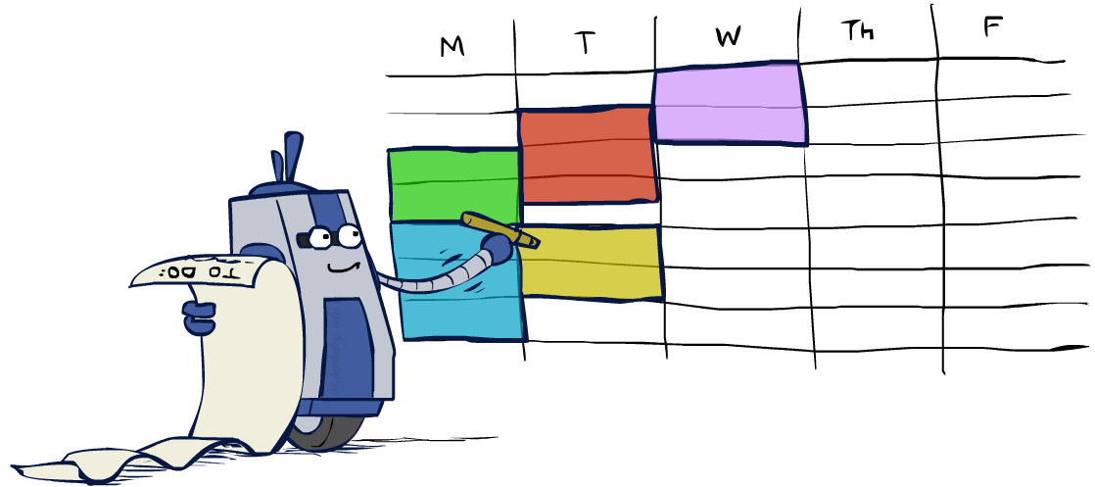
Summary: CSPs
CSPs are a special kind of search problem:
States are partial assignments
Goal test defined by constraints
Basic solution: backtracking search
Speed-ups:
Ordering
Filtering
Structure
Iterative min-conflicts is often effective in practice

Slide 26
Next Time: Adversarial Search!

